Slide 1

Introduction to Statistics and Descriptive Statistics
Bonan Zhao
b.zhao@ed.ac.uk

Slide 2

Before Starting…
Who am I - Bonan
PhD Student in Cognitive Psychology
Philosophy bachelor -> logic master -> data scientist -> PhD in Edinburgh
From humanities to computational
It’s fun! Data is another kind of storytelling
Digital skills free your mind
Avoid repetitive labor
Minimize human-error
Easy to share and reproduce
Give yourself confidence

Slide 3
Before Starting…
The Workshop
Format: Short presentation of theory, and then work through practical code together on R Studio – discuss questions as we go
Learning outcomes: Get a basic understanding of Statistics and apply this in R
Two parts
Basic presentation of Statistical Analyses
Practical run through of examples

Slide 4

What is Statistics?
Statistics is a branch of mathematics that helps us to understand data, through summarizing, analyzing and interpreting the data quantitatively.
https://www.sagepub.com/sites/default/files/upm-binaries/40006_Chapter1.pdf

Slide 5
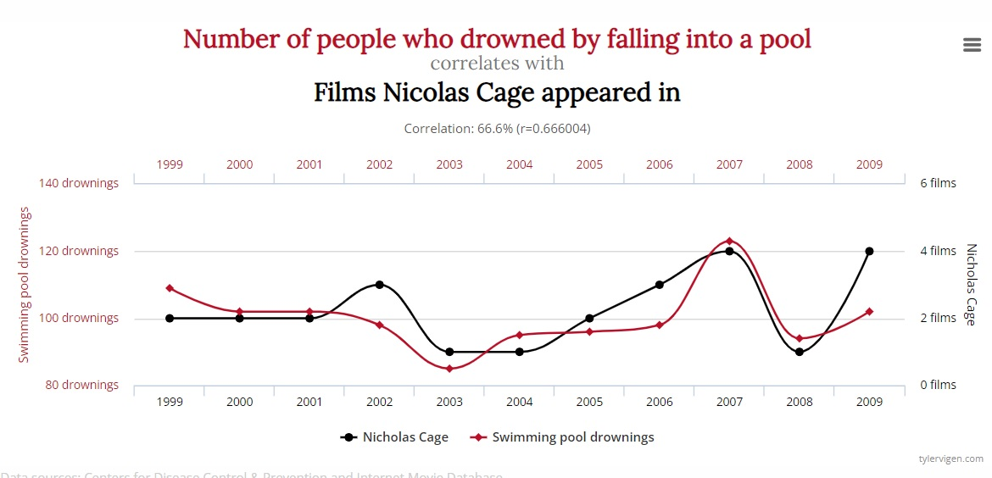
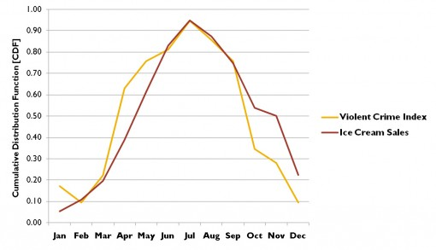
Correlation and Causation
It is important to understand the difference between causation and correlation while using statistics.
Correlation is an association between variables, when one changes, so does the other.
Causation is where change in one variable brings about change in another.
A correlation doesn’t imply causation, but causation always implies correlation.
https://www.scribbr.com/methodology/correlation-vs-causation/
http://www.tylervigen.com/spurious-correlations
https://www.skeptic.com/insight/the-logic-of-causal-conclusions-how-we-know-that-fire-burns-fertilizer-helps-plants-grow-and-vaccines-prevent-disease/

Slide 6
Why doesn’t correlation mean causation?
There are two main issues between causation and correlation; the third variable problem and the directionality problem.
The third variable is when a third variable causes the change in both observed variables, e.g. the temperature.
For directionality, two variables might have a causal relationship, but it is impossible to tell which one causes the change on the other, e.g. depression and Vitamin D deficiency.
https://www.scribbr.com/methodology/correlation-vs-causation/
https://www.skeptic.com/insight/the-logic-of-causal-conclusions-how-we-know-that-fire-burns-fertilizer-helps-plants-grow-and-vaccines-prevent-disease/

Slide 7
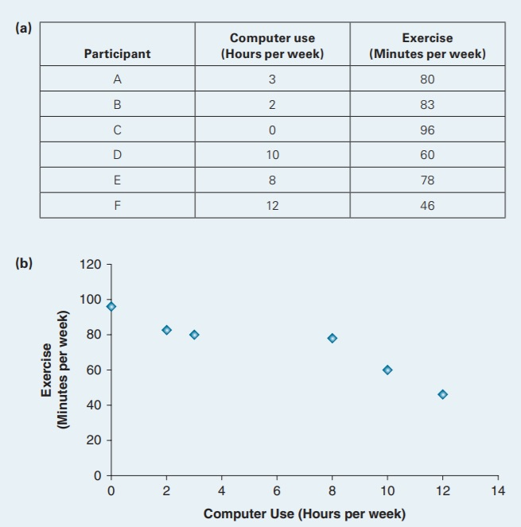
Correlational Research
Correlational research can identify correlations. It is conducted without controls.
It is difficult to draw any causal inferences without controlled experiments.
For example, asking a group how many hours per week they spend on a computer and exercising.
There is no control or attempt to create different groups in this experiment. While we can see a negative correlation between the two variables, we cannot confirm a causal relationship.
https://www.sagepub.com/sites/default/files/upm-binaries/40006_Chapter1.pdf

Slide 8
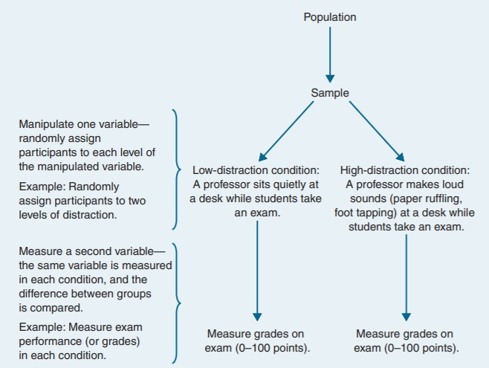
Experimental Research
In order to identify causation, the research and variables must be controlled.
For example, determining if high distraction environments lead to lower test scores.
If the test scores between these two groups differ, then we can begin to understand causation as well correlation.
This requires elements of randomization, manipulation and comparison.
https://www.sagepub.com/sites/default/files/upm-binaries/40006_Chapter1.pdf

Slide 9
Descriptive and Inferential Statistics
There are two main types of statistics, descriptive and inferential.
Descriptive Statistics are used to summarize data
Inferential Statistics are used to interpret the Descriptive Statistics
Today we will focus on Descriptive, but it is helpful to understand the difference between the two
https://www.sagepub.com/sites/default/files/upm-binaries/40006_Chapter1.pdf

Slide 10
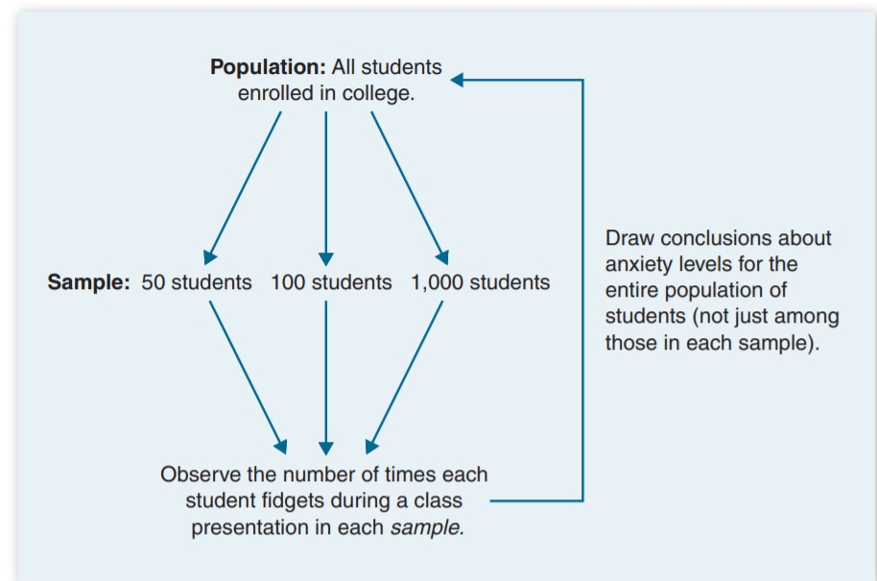
Inferential Statistics
Say we want to understand anxiety amongst a student population. We can try and assign a numerical observation to ‘anxiety’.
For example, the number of times a student fidgets during a class.
These values are taken from a sample of which is not necessarily the entire population.
This is where inferential statistics comes in, we can draw conclusions about the wider population by analyzing sub samples.
https://www.sagepub.com/sites/default/files/upm-binaries/40006_Chapter1.pdf

Slide 11
Descriptive Statistics
Descriptive Statistics can be thought of in three main groups; frequency distribution, central tendency and variability.
They help facilitate data visualization and presentation in an easily understandable and intuitive manner.
https://corporatefinanceinstitute.com/resources/knowledge/other/descriptive-statistics/

Slide 12
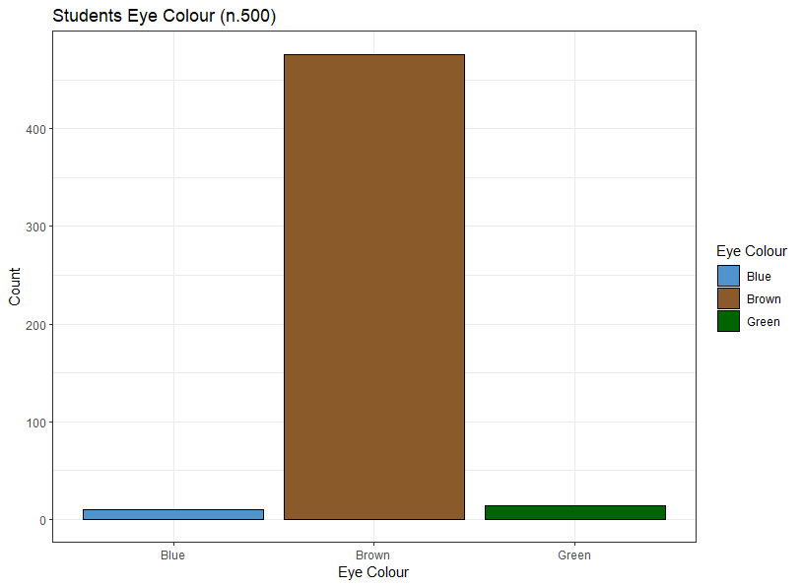
Descriptive Statistics
Frequency distribution shows the frequency or count of different outcomes. Normally presented as a table or graph.
https://corporatefinanceinstitute.com/resources/knowledge/other/descriptive-statistics/

Slide 13
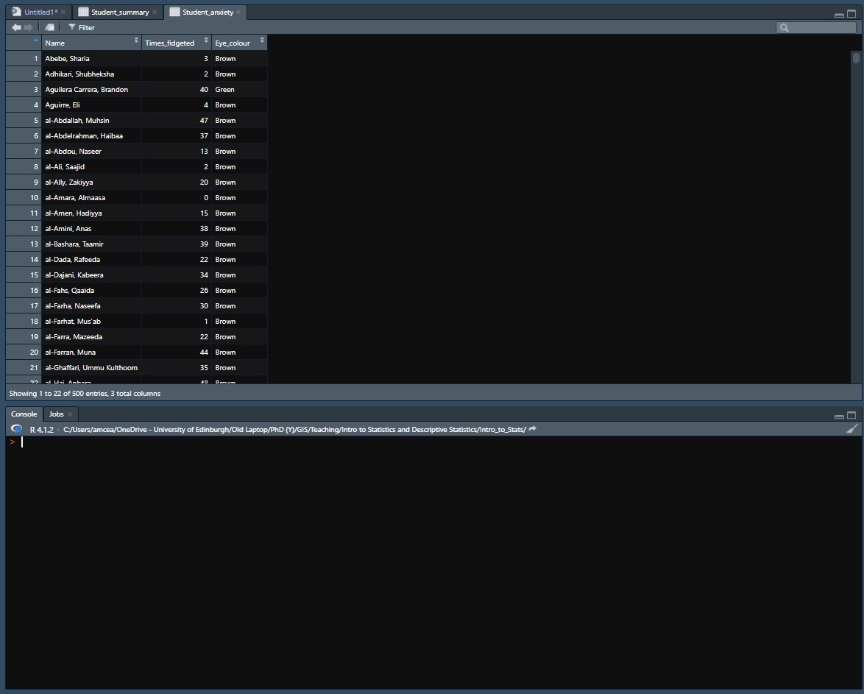
Descriptive Statistics
If we return to the student fidgeting example, lets see if we can see any correlation between eye color and anxiety.
Just providing a list of students with how many times they fidgeted and their eye color isn’t very useful.
https://www.sagepub.com/sites/default/files/upm-binaries/40006_Chapter1.pdf

Slide 14
Descriptive Statistics
Eye Colour | Mean Times Fidgeted
Blue | 22.5
Brown | 24.8
Green | 30.5
Instead, we can look at the central tendency of the data.
This looks at the average (mean), middle (median), or most common (mode).
This provides much more meaningful and easily interpretable results.
Eye Colour | Median Times Fidgeted
Blue | 22.5
Brown | 24
Green | 35.5
Eye Colour | Mode Times Fidgeted
Blue | 25
Brown | 31
Green | 40
https://www.sagepub.com/sites/default/files/upm-binaries/40006_Chapter1.pdf

Slide 15
Descriptive Statistics
Eye Colour | Range of Times Fidgeted
Blue | 8-43
Brown | 0-50
Green | 2-50
Variability gives further insight into the data, by looking at the degree of dispersion in a sample.
This uses range, standard deviation and variance.
This provides much more meaningful and easily interpretable results.
Eye Colour | sd of Times Fidgeted
Blue | 12.5
Brown | 14.6
Green | 14.9
Eye Colour | Mode Times Fidgeted
Blue | 155
Brown | 212
Green | 220
https://corporatefinanceinstitute.com/resources/knowledge/other/descriptive-statistics/

Slide 16
Descriptive Statistics
Can anyone spot a problem with the analysis we’ve done so far?

Slide 17
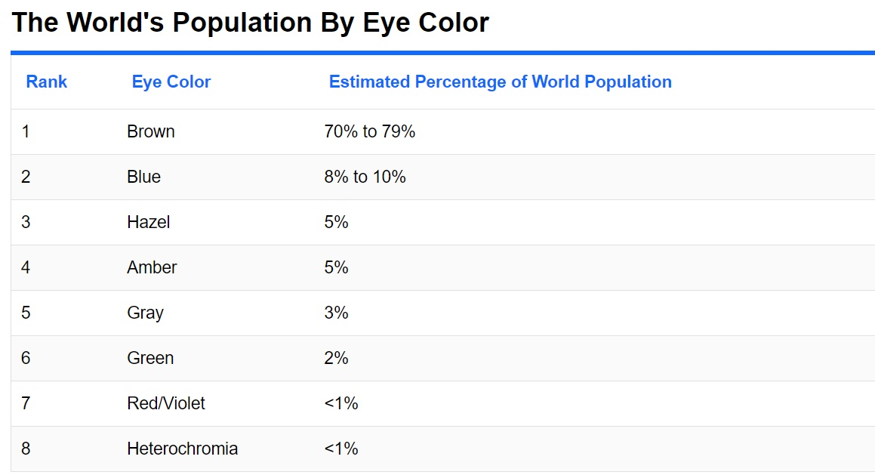
Sample Sizes
Representative Eye Color
https://www.qualtrics.com/uk/experience-management/research/determine-sample-size/?rid=ip&prevsite=en&newsite=uk&geo=GB&geomatch=uk
https://www.worldatlas.com/articles/which-eye-color-is-the-most-common-in-the-world.html

Slide 18

Probability Distributions
Distributions are a way of measuring and visualizing the probability of a certain variable having a specific value.
Think of flipping a coin, the chance of getting heads is ½, and the chance of getting tails is similarly ½. This is known as a binomial distribution.
Or rolling a standard dice, getting a number between 1-6 each has a chance of 1/6, while rolling a 7 has a chance of 0.
https://statanalytica.com/blog/distribution-in-statistics/

Slide 19
Probability Distributions
There are many kinds of distributions, we will focus on three of the most common today, Normal, Uniform and T.
https://statanalytica.com/blog/distribution-in-statistics/

Slide 20
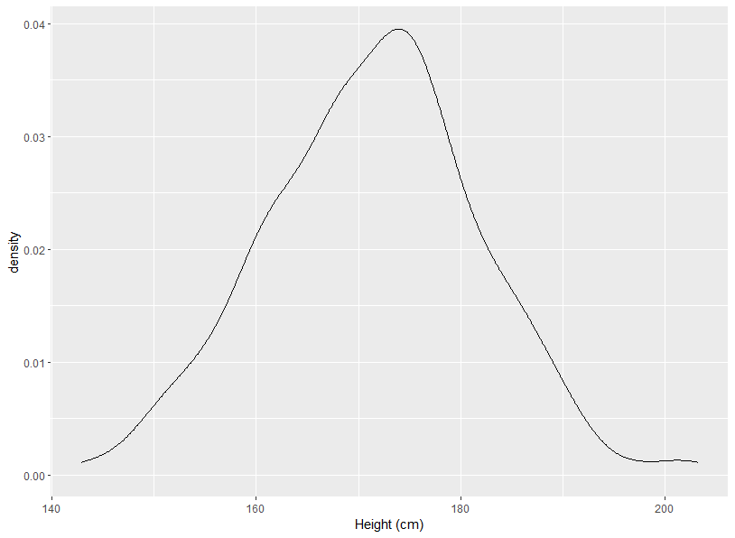
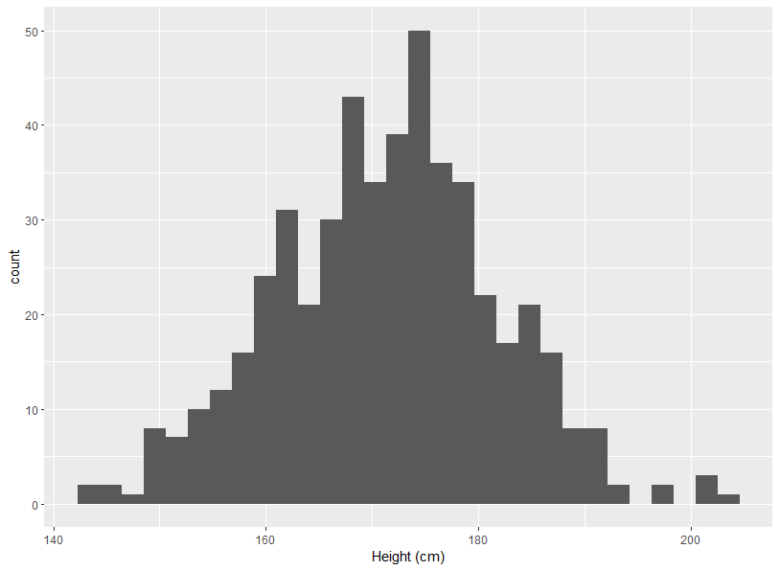
Normal Distribution
A normal distribution has many results around the mean/average, with a few which are lower and higher than this. For example, height. Most people are of average height, with some very tall and very short people too.
Normal distributions are symmetrical, and there are the same number of occurrences above and below the mean.
The mean, median and mode are always the same.
https://statanalytica.com/blog/distribution-in-statistics/

Slide 21
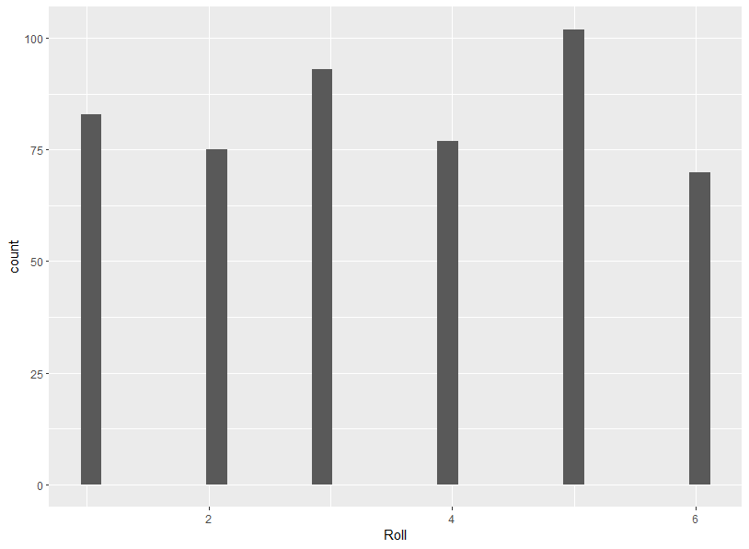
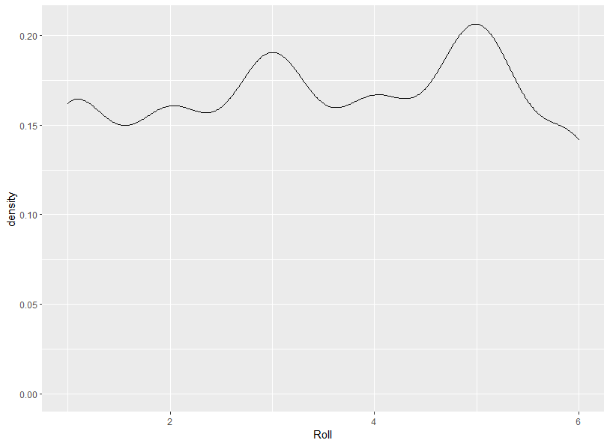
Uniform Distribution
A uniform distribution is where all outcomes are equally likely. E.g., flipping a coin, rolling a dice.
Uniform distributions can be continuous or discrete, having finite possible outcomes or infinite possible outcomes respectively.
https://corporatefinanceinstitute.com/resources/knowledge/other/uniform-distribution/

Slide 22
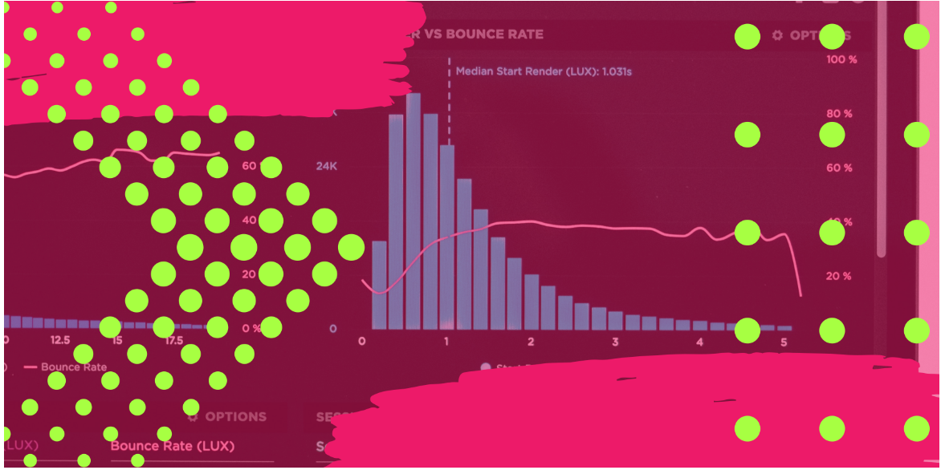
T Distribution
T distributions, or Students T-Distributions, are used to estimate the parameters of a population with a small sample size, or where the standard deviation is unknown.
These are a form of normal distribution that are very important for calculating probabilities, but that will have to wait for another day!
https://www.cdcs.ed.ac.uk/events/null-hypthesis-testing-with-r
https://corporatefinanceinstitute.com/resources/knowledge/other/uniform-distribution/

